Slide 1
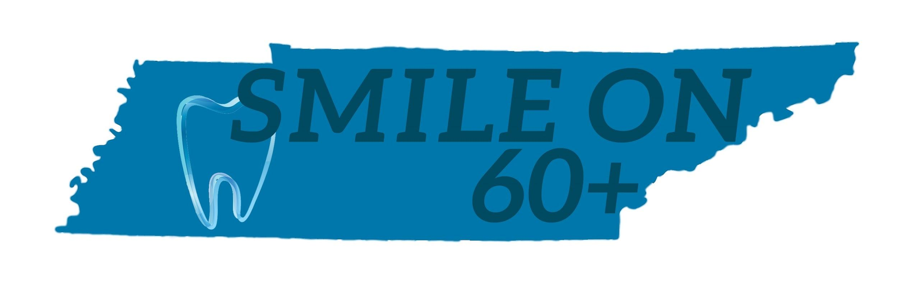

SMILE ON 60+ Analysis
DDA2 Cohort
DECEMBER 8, 2020

Slide 2
Agenda
Key Findings
Demographics
Program Effectiveness
Program Opportunities
Data Collection
Summary

Slide 3
Key Findings
8,707 unique patients, over 2.5 years
55% - had a treatment plan developed
65% - of patients with a treatment plan were restored to function
Program is being used by people where tooth loss is greatest - in urban areas
50% of questions related to treatment plan/restoration were incomplete

Slide 4
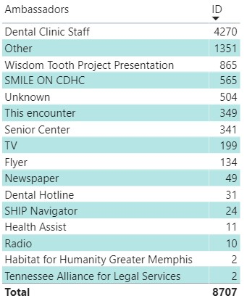

Smile-On Program Ambassadors

Slide 5
Who is being served?
Notes:
Age, Gender, Race, Condition of Teeth

Slide 6
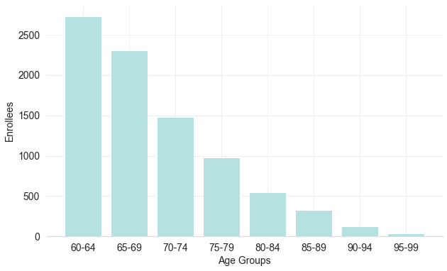
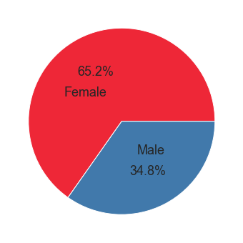
Age and Gender of Enrollees
Notes:
Paul

Slide 7
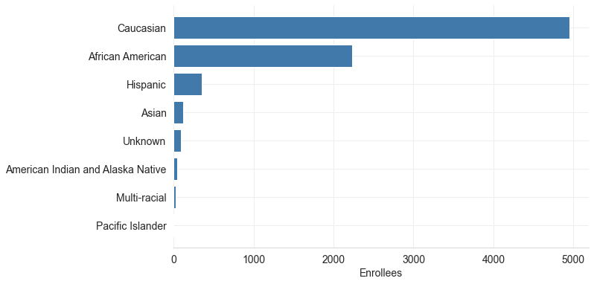
Race and Ethnicity of Enrollees

Slide 8
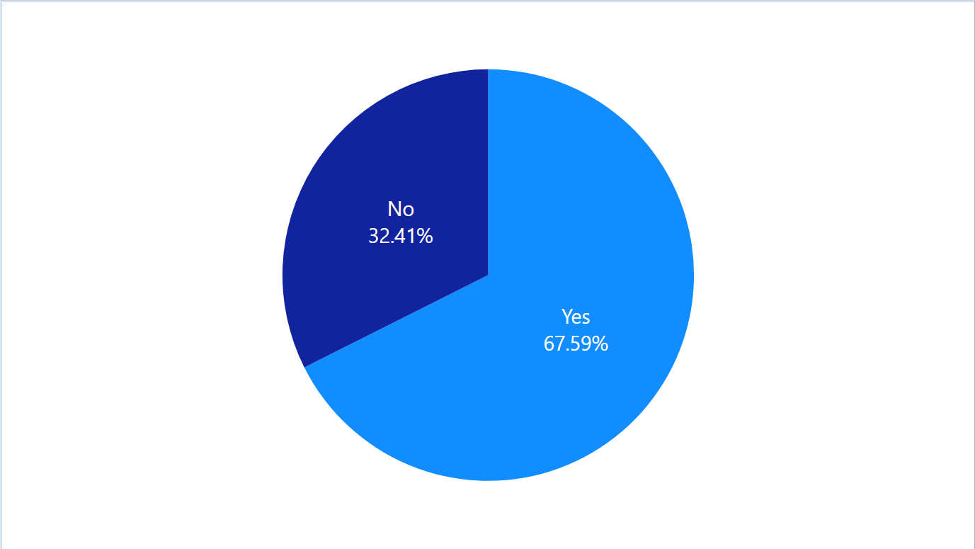
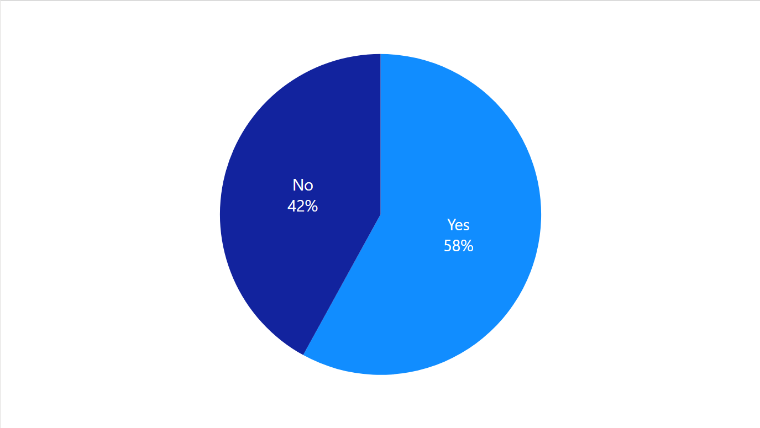
Pre-Screening Questions: Quality of Teeth
Does the appearance of your mouth affect your quality of life?
Are You Limited in What You Can Eat?
Notes:
Paul

Slide 9
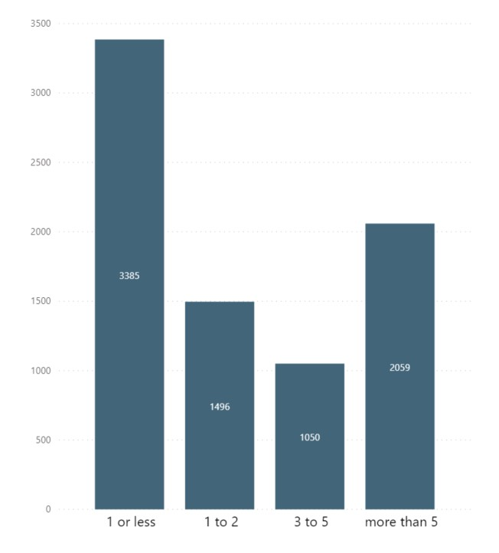
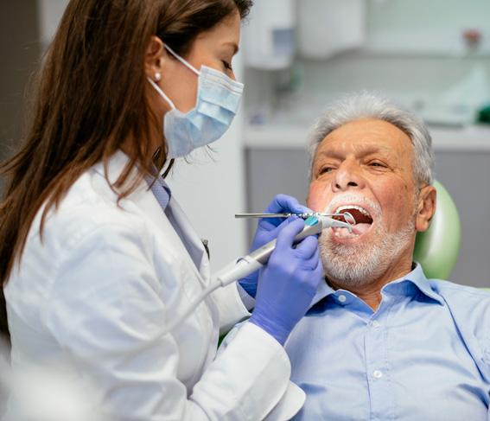
Years Since Last Dental Visit
42%
19%
13%
26%
Notes:
Paul - to Sreyas
These are the responses to “When is the last time you visited your dentist?” - It is notable that over a quarter of the people they are serving have not been to the dentist for over 5 years.

Slide 10
Program Effectiveness
Success Metrics
Most prevalent dental procedures
Have patients continued to use the Smile On Program - found a dental home
Has quality of life improved?
Number of treatment plans completed each month
Number of patients restored to function
Notes:
Sreyas lead

Slide 11
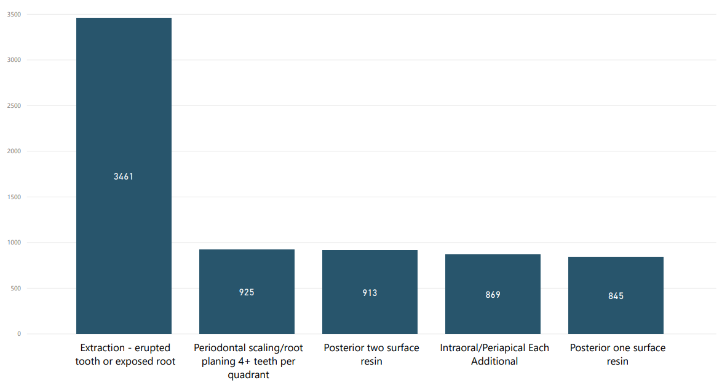
Most Common Procedures
Notes:
Sreyas - Extraction procedures contribute to overall restoration of function. We believe this is a positive sign of success/efficiency of the SmileOn program. Although this doesn’t tell us what type of work the patients are having done after the extractions, we do know that lots of patients are having teeth extracted in order to improve their overall dental quality, and therefore, ideally leading to function restored down the road.

Slide 12
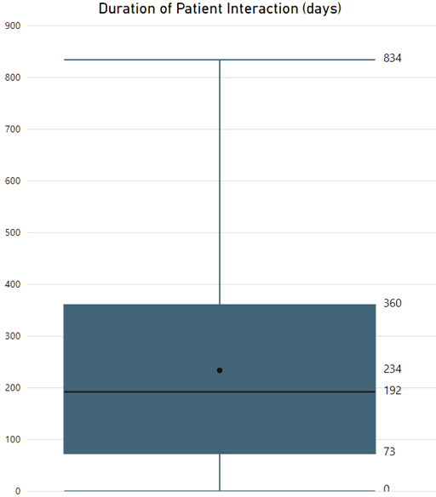
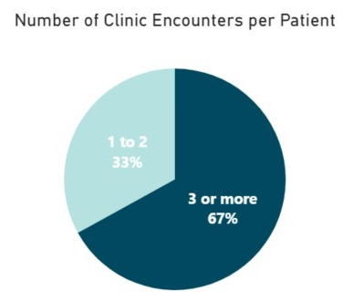
Finding a “Dental Home”
Notes:
Sreyas - A longer duration indicates a patient that has found a “dental home”. This slide shows the statistics for the patient population, as a whole, in relation to duration of interaction with the program. On the right, The chart shows the statistics related to the number of clinic encounters per patient. We see that more than 2/3 of patients have had at least 3 clinic encounters with the program. On the left, The number of days is calculated by taking the difference between the first contact with the patient and the date of the most recent contact. For duration of patient interactions, the average duration is 234 days, with a maximum of 834 days. 75% of the patients have been in the program 360 days or less. There were about 2000 patients who only interacted with the program once and have a duration of 0 days. That is roughly 23% of the total population.

Slide 13
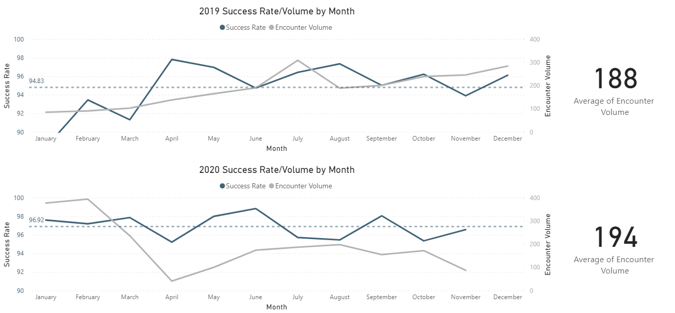
Treatment Plan Complete + Function Restored vs. Volume
Notes:
Heather - Success rate determined by subsetting only completed treatment plans and patients with restoration of function. Volume is the total amount of responses
For our next success metric we broke down the data by month. First looking at the patients that completed a treatment plan and then found the percentage of those patients whose mouth’s were restored to function, which is shown by the dark blue line in these line charts and corresponds to the y-axis on the left hand side. As you can see, we consistently see a high percentage of these patients being restored to function when their treatment plan is completed. We also looked at the total number of dental visits or encounters each month shown by the gray line, which corresponds to the y-axis on the right hand side. One take away here is that the average encounter volume increased from 188 encounters each month in 2019 to 194 in 2020 so far, which indicates program growth that will most likely increase by the end of 2020.

Slide 14
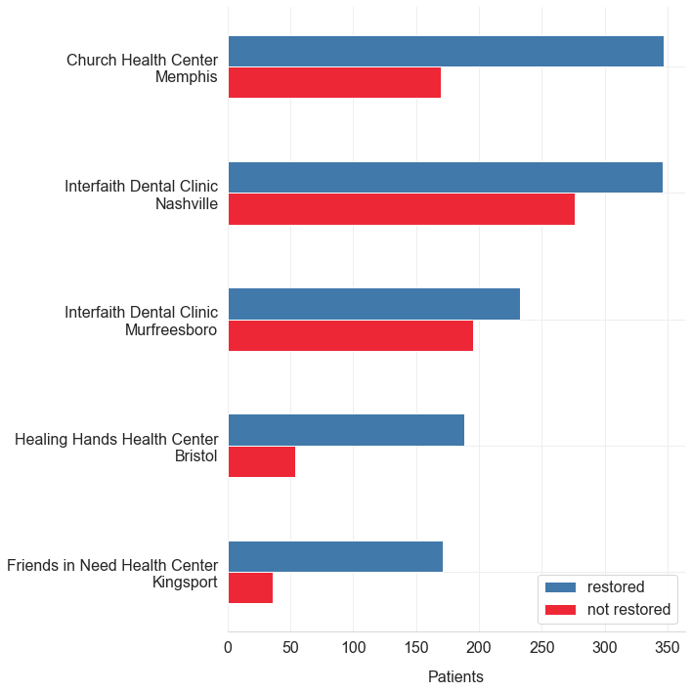
Clinic Locations with the Most Restored Patients
Restored based on clinic’s response to the question:
‘Was the enrollee able to be restored to function (can chew) and "social six" esthetics (top front six teeth are present and disease free)’
Notes:
Heather - We also looked at the number of people who were able to be restored to function by clinic. This was documented under the question was the patient restored to function, which means they are able to chew and have their front six teeth present. In this bar chart, we focused on the clinics that were able to restore the most patients to function as shown by the blue bars. The number of patients at these clinics who have not yet been restored to function as of their last visit are shown by the red bars.

Slide 15
SMILE ON 60+
Program Opportunities

Slide 16
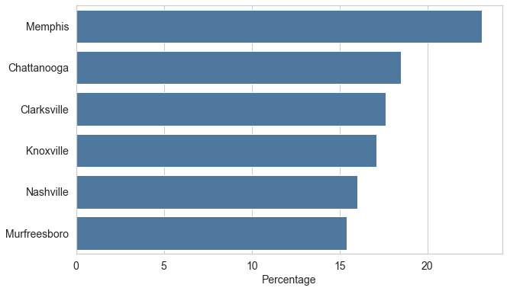
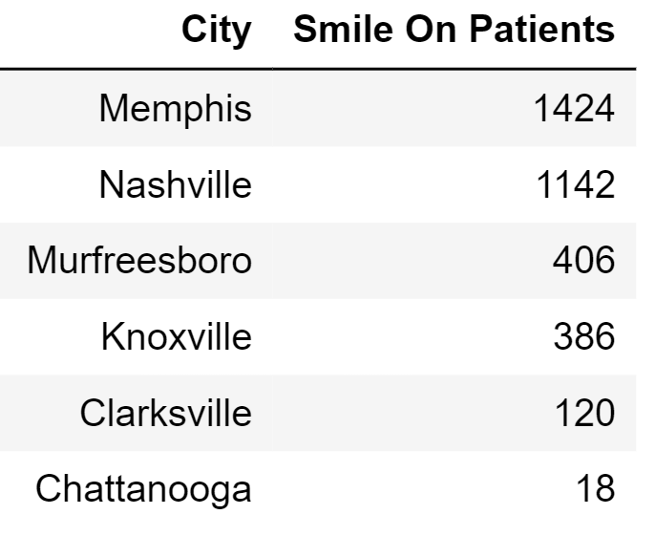

Percentage of Adults Over Age 65
with Complete Tooth Loss
*Total Number of Smile On Patients who live in each city

Slide 17
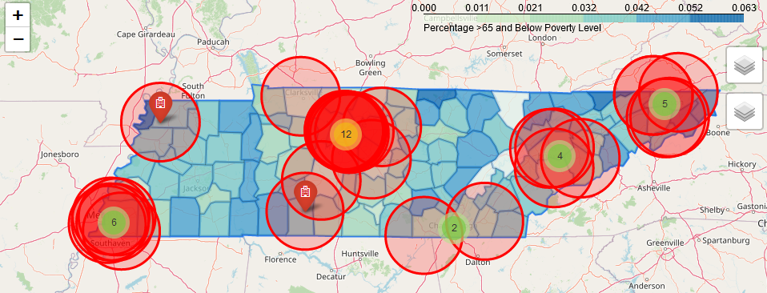
Population of Adults Over 65 Living Below the Federal Poverty Line
(30 mile radius from a provider partner clinic)
http://data-playground.com/dda2/jdcg_age_poverty_map.html
Potential gaps in coverage
Notes:
Opportunities for smile on program in rural areas, 30 miles is about a half an hour drive on the interstate and in rural areas could stretch to much further. This data was obtained from the Tn Commission on aging and disability

Slide 18
Big Four Factors Contributing to Tooth Loss
The American Dental Association identified the following factors:
Excessive Alcohol Consumption - 5 or more drinks for men or 4 or more drinks for women in the span of 2 hours
Smokers - The percentage of adults who smoke daily
Obesity - Calculated by a combination of self reporting and CDC data, finding adults who report a BMI > 30
Inactivity - Physical inactivity is the percentage of adults ages 20 and over who reported no leisure-time physical activity in the past month.

Slide 19
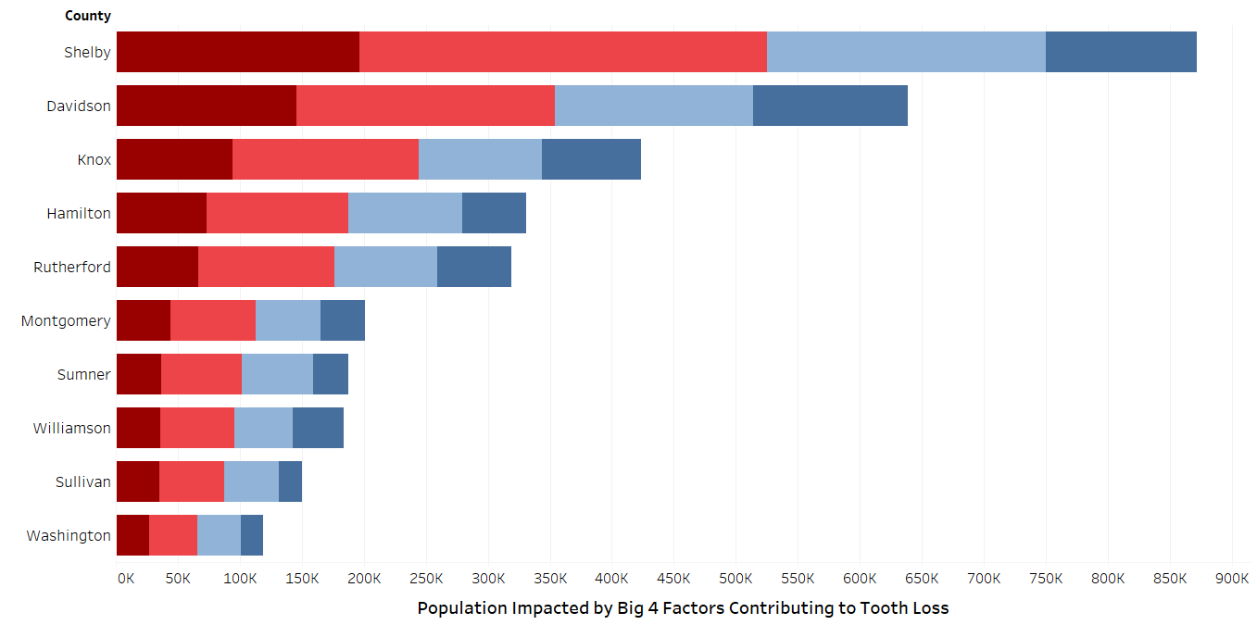
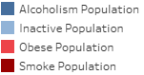
Big Four by County
Notes:
Cory - According to the ADA, the top four contributing factors to tooth loss are excessive drinking, smoking, obesity, and inactivity. This chart shows the population within each county that exhibits these behavioral and health conditions.

Slide 20
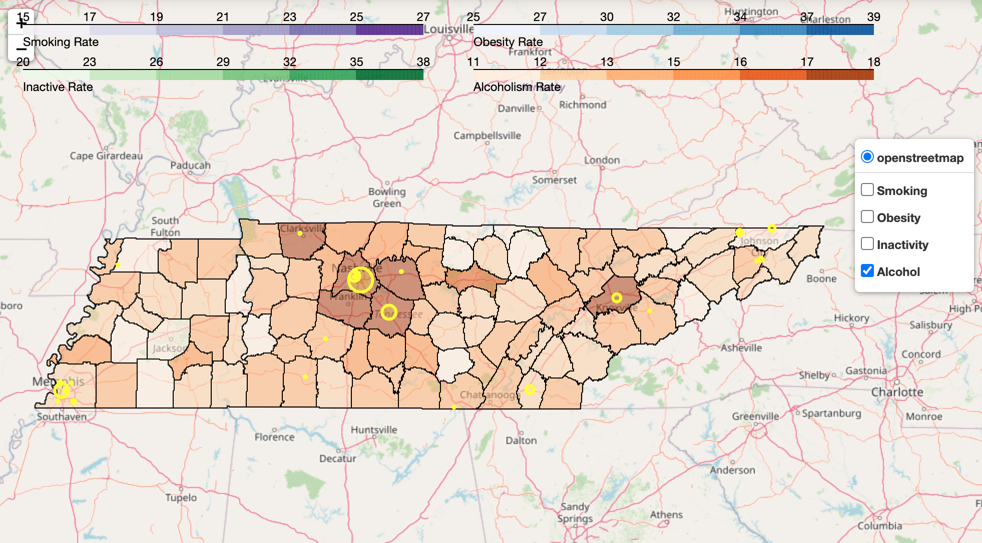
Big Four: Excessive Alcohol Consumption
Excessive alcohol consumption is a pattern of binge drinking, or 4+ drinks in a 2 hour window multiple times per week.
Notes:
Knox, williamson, davidson, wilson, montgomery

Slide 21
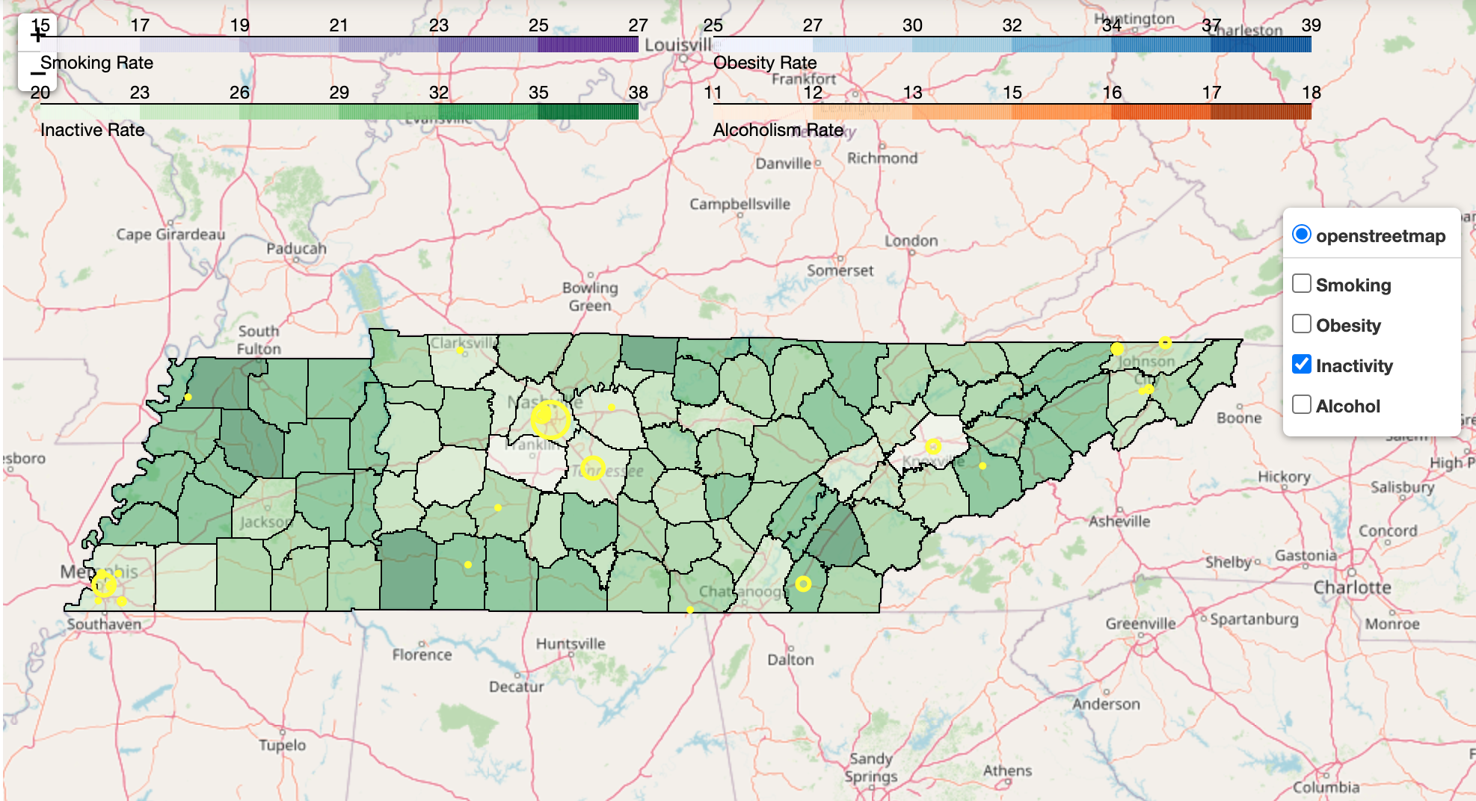
Big Four: Inactivity
Physical inactivity is the percentage of adults ages 20 and over who reported no leisure-time physical activity in the past month.
Notes:
Wayne, Gibson, mcminn

Slide 22
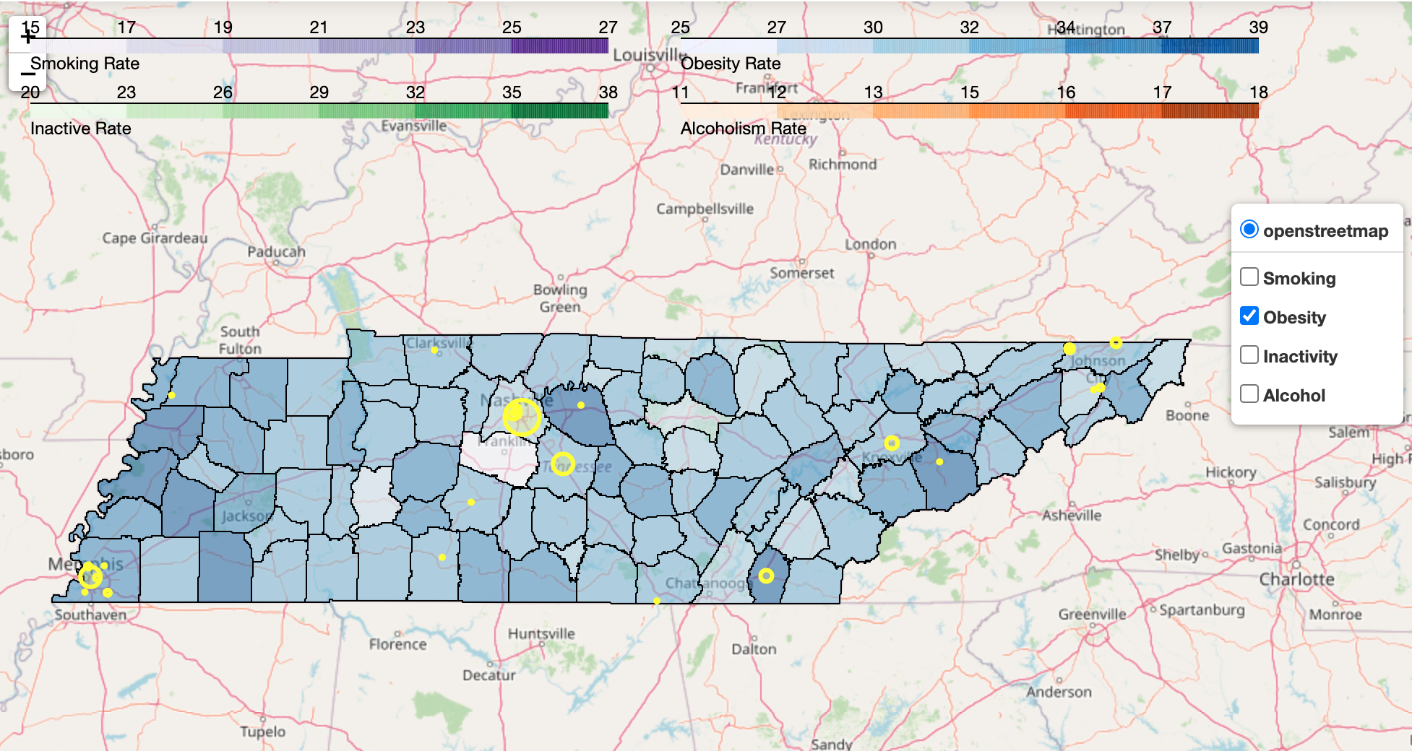
Big Four: Obesity
Adult obesity is calculated by a combination of self reporting and CDC data, finding adults who report a BMI within the index.
Notes:
Hardeman, haywood, lauderdale

Slide 23
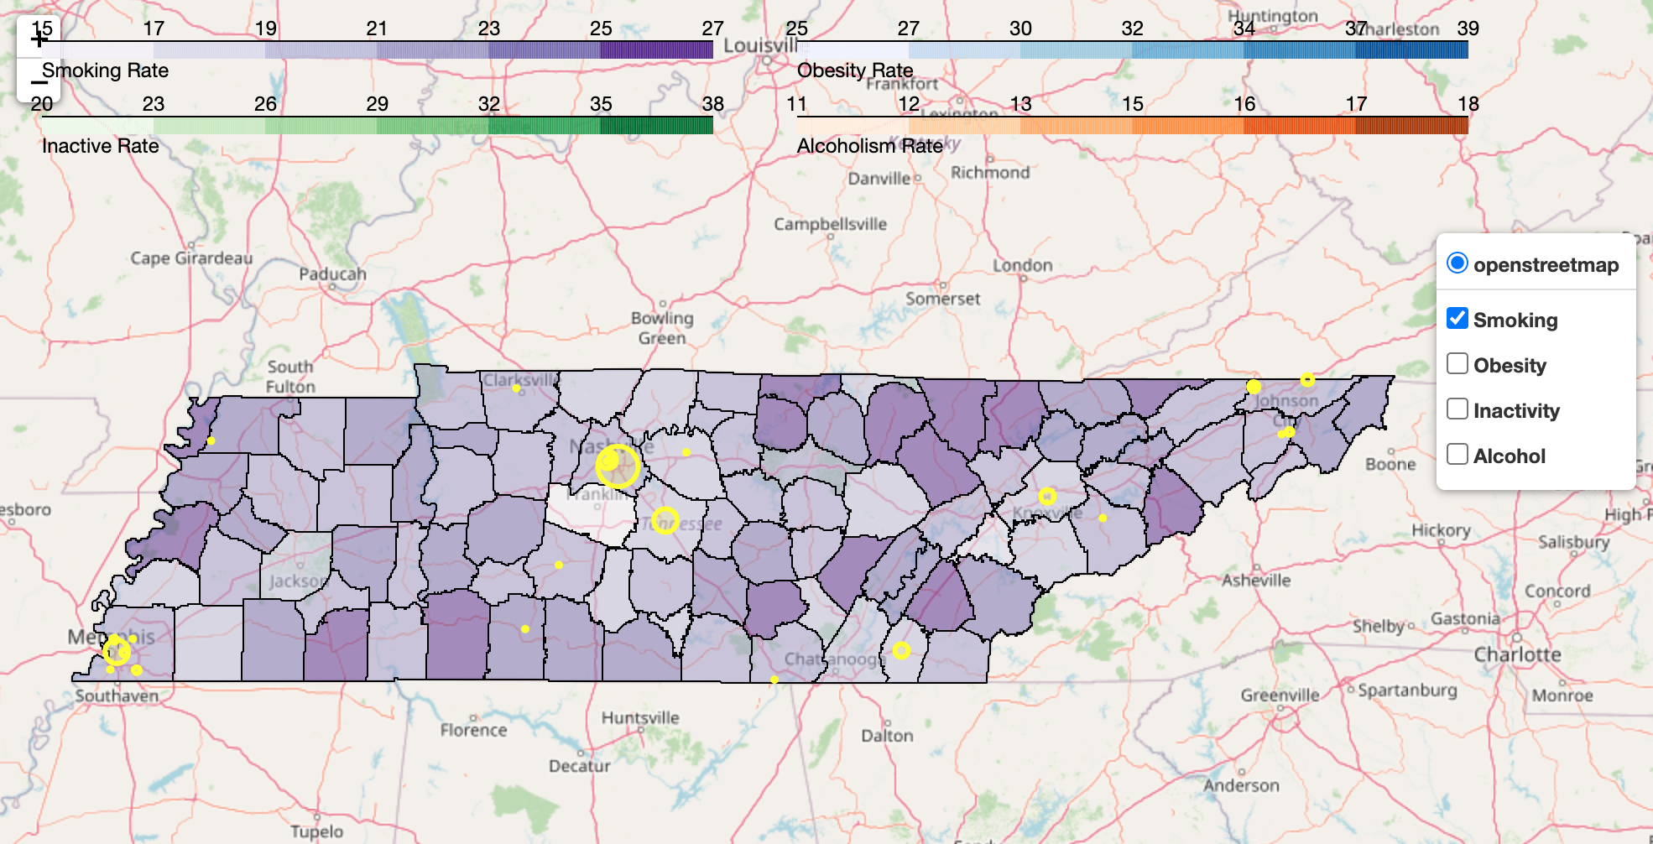
Big Four: Smoking
The smoking percentage is defined as the percentage of county adults who smoke daily.
Notes:
wayne, scott, campbell, fentress

Slide 24
Interactive Maps
Age_Poverty_Map: http://data-playground.com/dda2/jdcg_age_poverty_map.html
Big_Four_Map: http://data-playground.com/dda2/mia_big_four_map.html

Slide 25
Data Collection

Slide 26
Answer Completion Rate - Overall 49.6%
How often do clinics answer these three questions during patient visits?
Is the treatment plan completed?
Was a treatment plan created?
Was the enrollee able to be restored to function?
Answer Completion Rate =
How many non-blank entries were recorded for the above questions
The total possible answers that could have been recorded

Slide 27
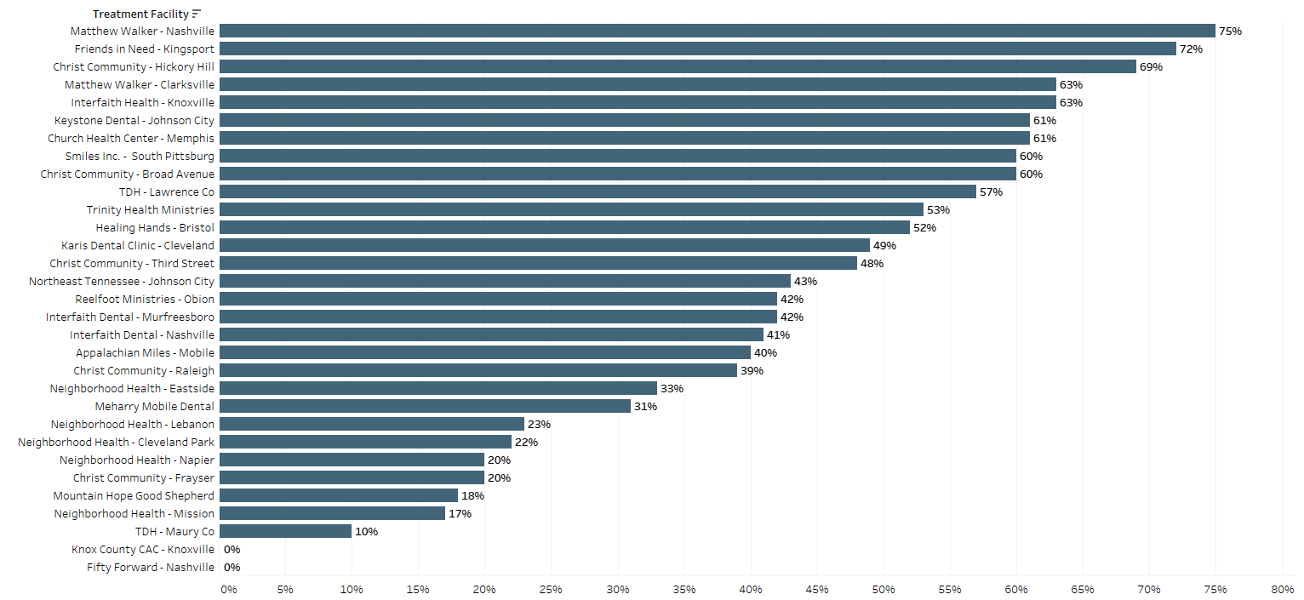
Answer Completion Rate by Clinic
Notes:
Percentage of important questions that clinic failed to complete on the survey. The questions are The clinic either answered yes or no or left blank of the three questions at the end of the survey: 1) Was a treatment plan developed? 2) Was a treatment plan completed? 3) Was function restored? Total completion rate is 49.6%

Slide 28
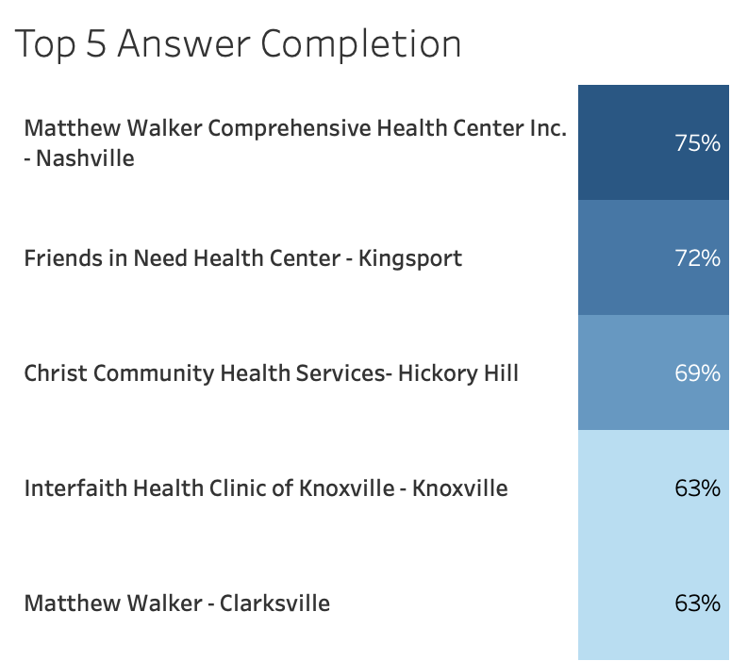
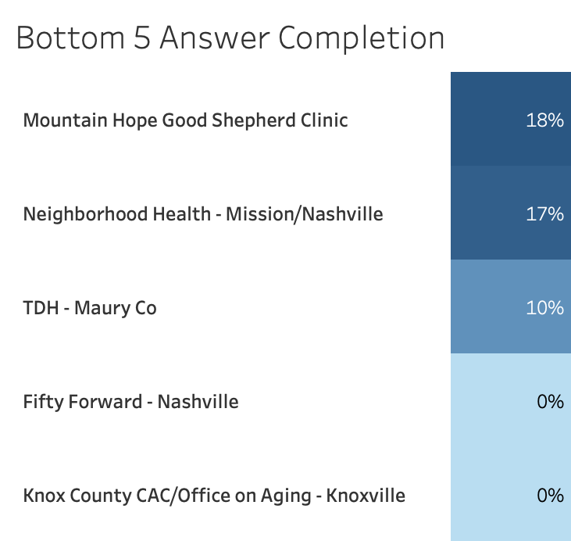
Answer Completion Rate - Top 5 & Bottom 5
Notes:
These are the top 5 and bottom 5 clinics based on their answer completion rate of the three survey questions listed at the top of the slide. This could be used to identify clinics that could improve on data collection. Could Smile On reach out to these clinics to understand why the completion rates are so low?

Slide 29
Summary
Conclusion:
Smile On 60+ program is effective in improving the quality of life for seniors
Opportunity for program in rural areas
Recommendation:
Need for more complete data collection from clinics

Slide 30






Group GitHub Repositories
https://github.com/NSS-Full-Time-Data-Analytics-2/smile-on-spiderman
https://github.com/NSS-Full-Time-Data-Analytics-2/smile-on-black_panther
https://github.com/NSS-Full-Time-Data-Analytics-2/smile-on-aquaman
https://github.com/NSS-Full-Time-Data-Analytics-2/smile-on-hulk
https://github.com/NSS-Full-Time-Data-Analytics-2/smile-on-lava-girl
https://github.com/NSS-Full-Time-Data-Analytics-2/smile-on-ironman

Slide 31
Sources
Smile On 60+ data provided by Ben Shuler on November 30, 2020
CMS Physician and Other Supplier Payments: https://www.cms.gov/Research-Statistics-Data-and-Systems/Statistics-Trends-and-Reports/Medicare-Provider-Charge-Data/Physician-and-Other-Supplier2017
Healthcare Common Procedure Coding System (HCPCS) - Ambulatory Payment Classification (APC) Crosswalk: https://www.cms.gov/Medicare/Medicare-Fee-for-Service-Payment/HospitalOutpatientPPS/Addendum-A-and-Addendum-B-Updates
CDC Teeth Loss: https://chronicdata.cdc.gov/500-Cities-Places/500-Cities-Local-Data-for-Better-Health-2019-relea/6vp6-wxuq/data
TN State of Aging Report (2019):https://www.tn.gov/aging/administration/forms-and-publications/2019-state-of-aging-in-tennessee.html
Tennessee Health Rankings (2020): https://www.countyhealthrankings.org/app/tennessee/2020/overview

Slide 32
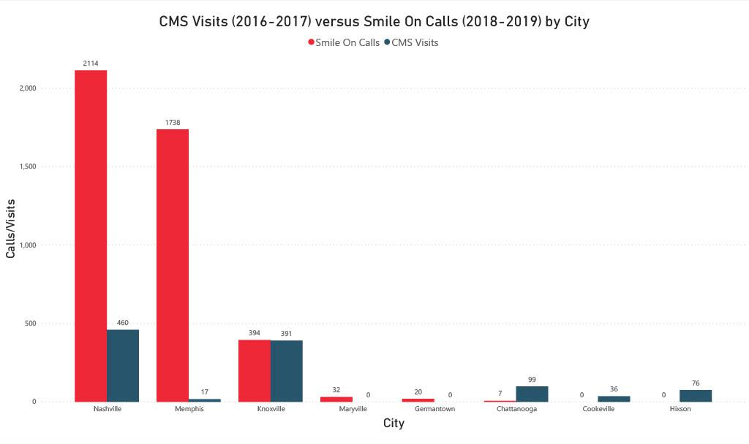
Notes:
Data taken from two years from each dataset, then averaged to per year. CMS data only shows 8 cities, so the Smile On data was compared to those cities. CMS data for Memphis was very low for some reason.
Comparing CMS data to Smile On data does not lead to any concrete conclusions, but it does look like the Chattanooga market (which includes Hixson) is a bit underserved.

Slide 33
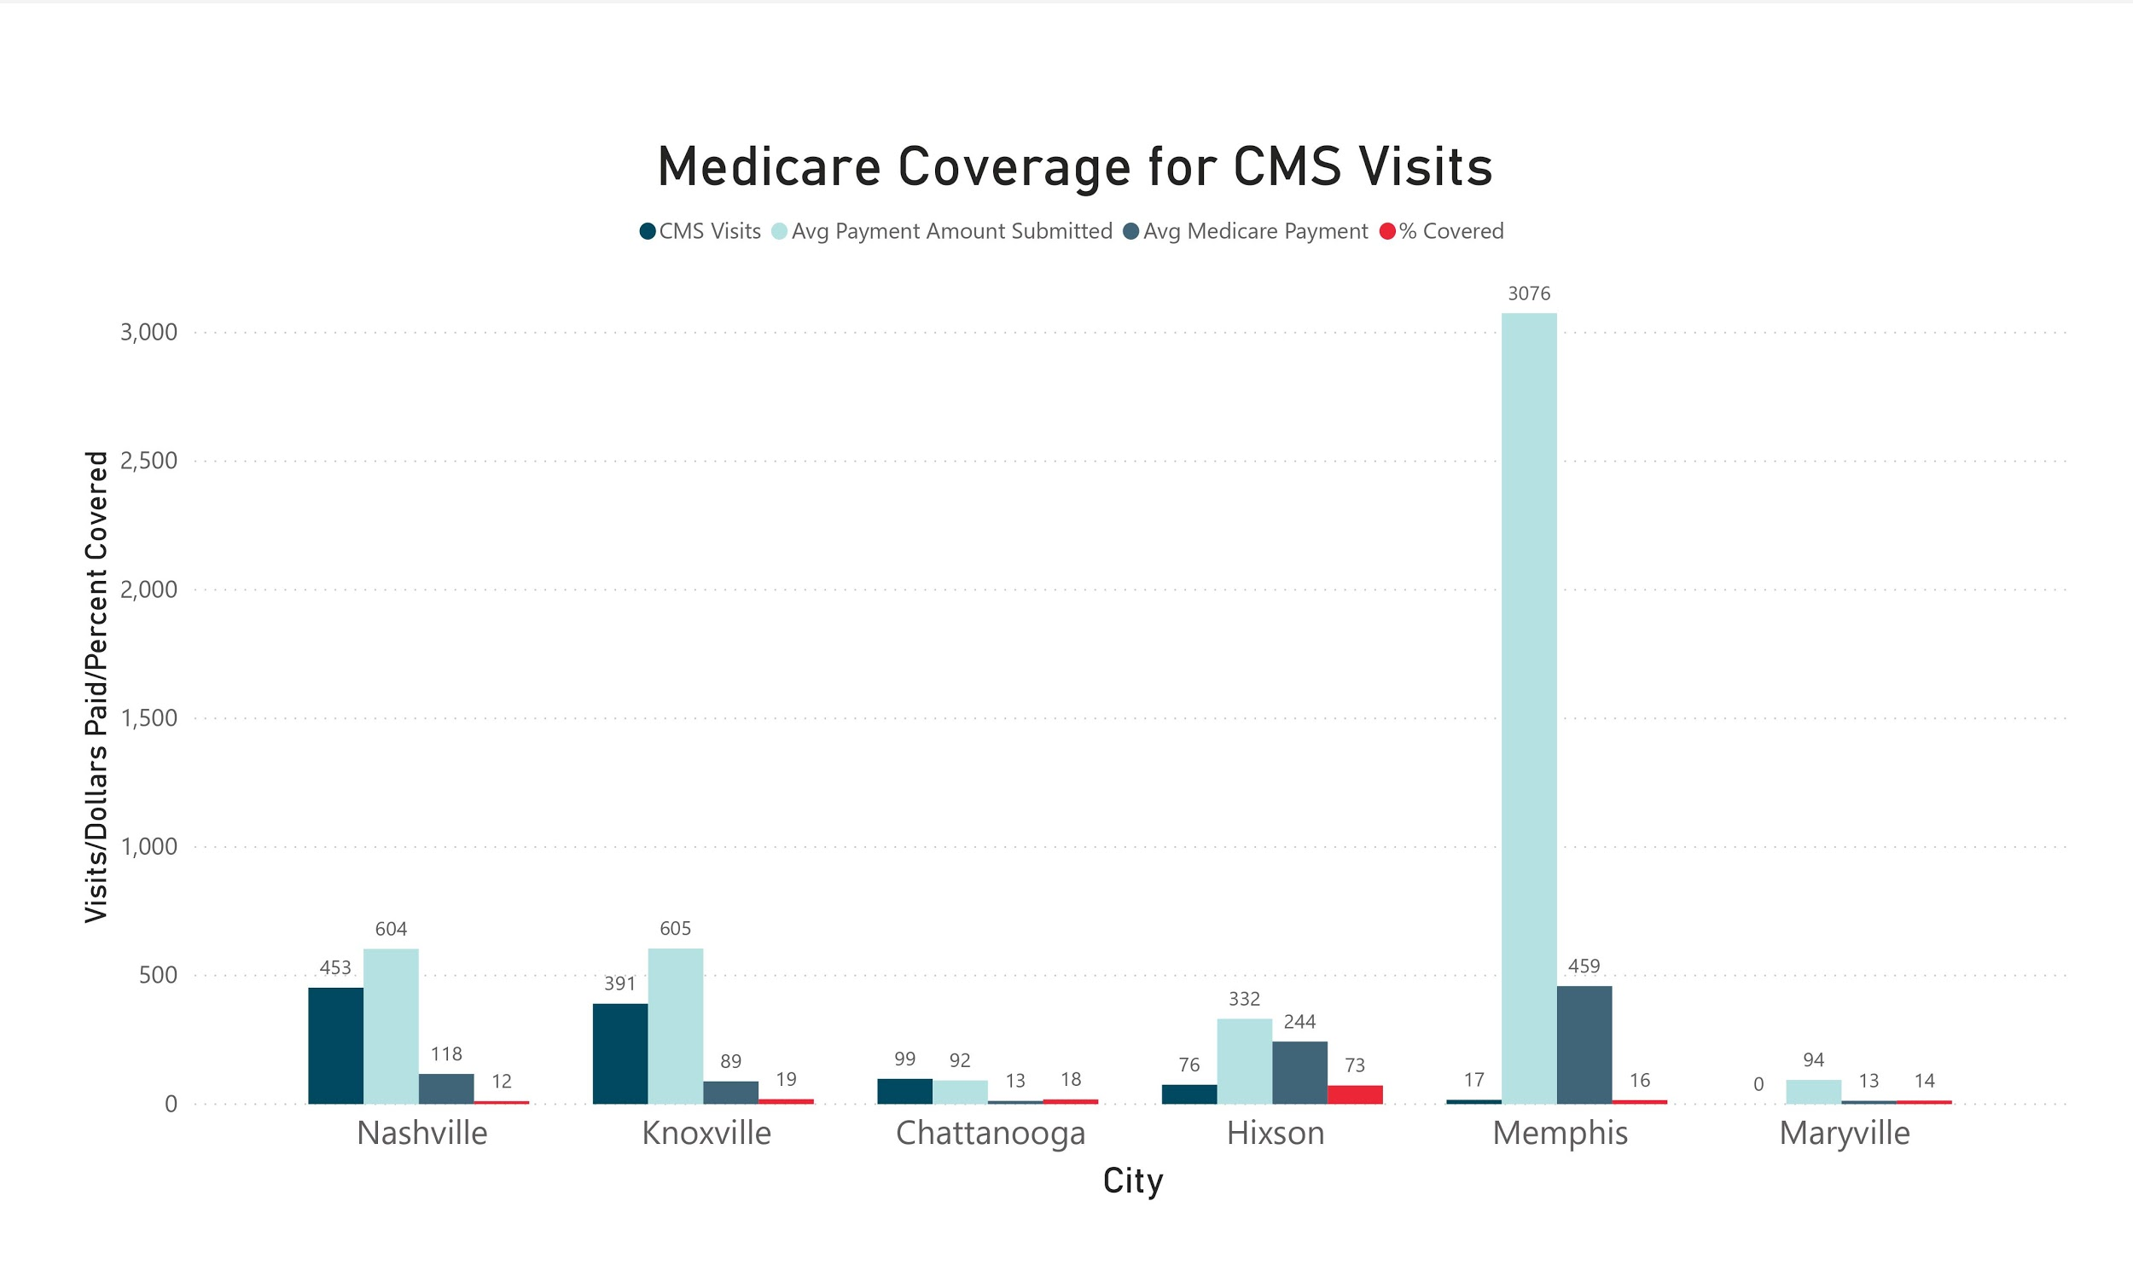
Notes:
First bar - Average CMS visits for years 2016-2017
Second bar - Avg payment amount submitted to CMS
Third bar - Avg amount paid by CMS
Fourth bar - % paid by CMS
Most procedures were for teeth xrays, which generally costs less than $100 (find this amount). Nobody in Memphis is getting teeth x-rays. Procedures there are for more expensive things like tongue biopsies and removals.
Posible takeaways:
Nobody in Memphis needs x-rays
Doctors and dentists in Memphis are opting out of accepting CMS patients
Patients in Memphis going to Smile On for xrays instead of going through CMS. Maybe to avoid out-of-pocket expenses?
Also, what about other cities in TN like Murfreesboro, Clarksville, Cookeville, Bristol?

